Slide 1

Equity valuations: The art and science of picking stocks
J.P. Morgan Investment Academy Series
SM
Notes:
Thank you for joining us today for another installment of our Investment Academy series.
I’m __________name/title________ and today we’re going to discuss one of the more interesting market-related subjects; one that always seems to capture the imaginations of both beginners and veterans: valuing equities. That is, how portfolio managers evaluate and choose stocks.

Slide 2

Introduction
FOR INSTITUTIONAL USE ONLY / NOT FOR PUBLIC DISTRIBUTION
Notes:
Before we get started, think for a minute about the last time you bought a car.
More than likely your hunt started with research; reading consumer reports or car magazines; taking a test drive; talking to others. You probably thought through some of the mechanics of buying versus leasing or the advantages of buying a new car over a used car. With the price of gasoline on the rise, maybe fuel efficiency was high on your wish list. You might have considered a luxury automobile, an SUV or a mid-sized car that would comfortably seat four or five passengers.
In a way, the methodical process you might employ when considering the purchase of a car is similar to what a portfolio manager does when choosing stocks for a portfolio. Are you looking for a bargain or are you willing to pay a premium for just the right model and performance features? Is it a long-term investment, or just a short-term solution.

Slide 3


A history that captivates
FOR INSTITUTIONAL USE ONLY / NOT FOR PUBLIC DISTRIBUTION
Notes:
The evolution of the automotive industry and stock market investing actually have a lot in common.
At the beginning of the 20th century, the automobile was marketed as a toy for the privileged class – the same minority that most likely would have owned stocks at the time.

Slide 4

Stock investing: An expanding universe
FOR INSTITUTIONAL USE ONLY / NOT FOR PUBLIC DISTRIBUTION
Notes:
Like car ownership in post-War America, stock market investing became mainstream later in the 20th century thanks to the growing popularity of mutual funds, enabled by technology and fostered by the introduction of individual retirement accounts in the 1980s.
In Jerry Markham’s book, The Financial History of the United States, his research shows that only 4.2% of the U.S. population owned stocks in 1949. By the end of 2012, the Investment Company Institute reports that nearly half of all U.S. households own equities in the form of mutual funds, exchange traded funds.
Investment choices in the 1950s also were limited. The idea of mutual funds was just being formulated, the concept of overseas investing was non-existent, and prices were difficult to obtain except through a stockbroker.
Today there are thousands of stocks available for purchase in the U.S. alone.

Slide 5
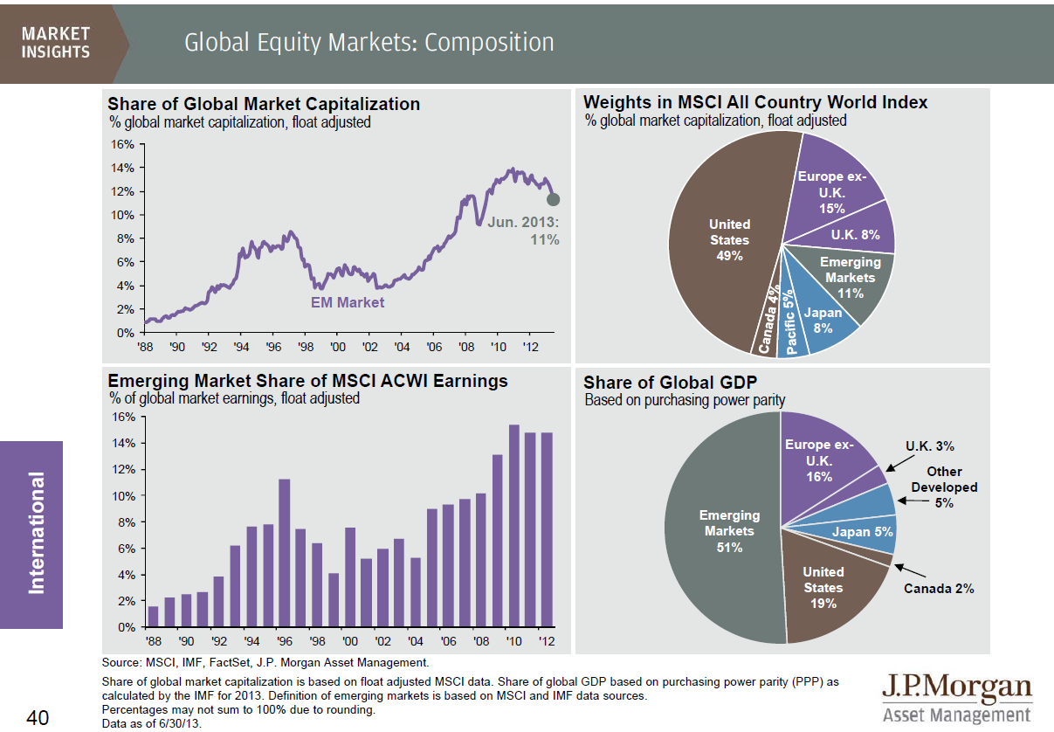
A global marketplace
FOR INSTITUTIONAL USE ONLY / NOT FOR PUBLIC DISTRIBUTION
Notes:
And when you consider both developed and the fast-growing emerging markets outside the United States…the number and type of choices is staggering. In a way, the global automotive industry – with automakers like Ssangyong , Vauxhall Corsa, Peugeot Citroen, Hyundai, Skoda, and Perodua – is a microcosm of the broad and growing equity markets.
While the U.S. dominated the world’s stock market opportunity for most of the 20th century, this slide from our popular Guide to the Markets shows that U.S. markets constitute less than half of the opportunity in 2013, as measured by the MSCI All Country World Index. Market capitalization, as you’ll recall, is the total market value of a company's outstanding shares.
When an investor considers the greater opportunity set worldwide, the universe of stocks exceeds 50,000, according to the World Federation of Exchanges, an association of regulated exchanges around the world.
With so many opportunities, how do money managers select stocks for their portfolios?

Slide 6
Narrowing the universe
Geography
Size: large, medium, small
Large cap companies tend to grow slower
Smaller companies tend to be more volatile
Larger companies are traded more frequently and more information is available about them
Industry/sector
FOR INSTITUTIONAL USE ONLY / NOT FOR PUBLIC DISTRIBUTION
Notes:
Thinking back to our automotive metaphor, one of the first things portfolio managers do is narrow the universe of choices available to them.
As an industry, we conveniently classify companies into groups that share characteristics. We do the same thing with cars –grouping them by types – light trucks, sports cars, sedans, SUVs. One of the most common ways to quickly segment a universe of stocks is to decide whether you want to look at U.S. domestic stocks, international stocks, or a combination. A manager could narrow the stock universe by geography, depending on the portfolio’s objectives.
Another screen portfolio managers use is market capitalization. A “stock screen” is industry lingo for the criteria you establish to sift through large amounts of information, and reduce the number of companies to a more manageable amount.
As we assessed a value for the world’s stock markets earlier, market capitalization at the stock level – or market cap as it is more commonly known – is a technical term that helps gauge what a company is worth. The industry commonly divides companies into large-, medium- and small-cap groups – as well as sub-groups, on both ends of the spectrum such as “mega cap” and “micro cap”.
Does size matter? In short, yes; a company’s size can be a major factor for investors when deciding which stocks to buy. Volatility is often dictated by size. Historically, large cap stocks have experienced slower growth with lower risk, while small cap stocks have experienced higher growth potential, but with higher risk. So investors can gauge the appreciation- versus the risk-potential of a stock by looking at market capitalization. Size also influences the amount of information available on the company. Larger companies tend to have more information available about them – and tend to be followed more closely by more analysts than small companies.

Slide 7










Many firms, including J.P. Morgan, organize research by sector
Research analysts
Financials and property
Transport services
Media
Consumer
Energy
Healthcare
Cyclicals
Technology
Telecoms
Utilities
FOR INSTITUTIONAL USE ONLY / NOT FOR PUBLIC DISTRIBUTION
6
Notes:
Stocks are also categorized by various industry sectors. One obvious reason is that companies within the same industries tend to face similar business challenges – whether it’s supply and demand, labor issues, materials and manufacturing or legal issues. Analysts and portfolio managers often view companies together in a peer-to-peer setting that enables them to compare companies that are thriving to those that may be struggling.
In this slide we demonstrate how our global research analysts are organized around various sectors. Specialization enables them to drill down further within a particular industry to better understand the mechanics and the players in a given field.
In our case, each analyst covers 30-35 companies, and makes somewhere in the neighborhood of 5,000 company contacts a year. In addition to meetings with a company’s senior management, they reach out to suppliers, competitors and customers to form a holistic view on companies. Their research may focus on any number of areas – such as:
Assessing a company’s business philosophy; it’s business model; and its competitive landscape
Measuring the quality and integrity of management
Validating market news and consensus forecasts
Identifying risk factors
Exploring future investments, capital expenditures, use of free cash flow, etc
Analyzing and forecasting earnings, cash flow and growth potential

Slide 8
Stock picking strategies
“Long ago, Ben Graham taught me that ‘Price is what you pay; value is what you get.’ Whether we’re talking about socks or stocks, I like buying quality merchandise when it is marked down.”
WARREN BUFFET
Notes:
So let’s take a few minutes to talk about some of the basic methods professional investors use to select stocks.
Before we do that, though, I’d like to start with a quote from Warren Buffet’s 2008 letter to Berkshire Hathaway shareholders. You’ll recall that 2008 was a very challenging year for all investors, characterized by the global financial crisis that witnessed a real estate market collapse, severe stock market declines and failures of several financial institutions. Mr. Buffet wrote: “Long ago, Ben Graham taught me that ‘Price is what you pay; value is what you get.’ Whether we’re talking about socks or stocks, I like buying quality merchandise when it is marked down.”
No matter what the market cycle, a stock’s price may not be its true value – truly understanding the long-term value of an investment is what drives innovation – and there are almost as many styles and approaches to evaluating stocks as there are investors.

Slide 9
Stock picking strategies
Fundamental analysis
Qualitative analysis
Value investing
Growth/income investing
GARP investing
Behavioral investing
CAN SLIM:
C = Current quarterly earnings per share
A = Annual earnings per share
N = New – product, managements, industry innovations
S = Supply and demand; Shares outstanding - This should be a small and reasonable number
L = Leaders – or laggards
I = Institutional sponsorship
M = Market direction
Dogs of the Dow
Technical analysis
FOR INSTITUTIONAL USE ONLY / NOT FOR PUBLIC DISTRIBUTION
Notes:
Here we’ve listed some of the most common methods for evaluating stocks. The point is that there is no single way to choose stocks – there are hundreds of methods. No two organizations follow the same process; and some combine several methods.
At one end of the spectrum is fundamental analysis – which attempts to measure the intrinsic value of a company by looking at both financial and qualitative factors. The theory is that if the true value is greater than the stock price – that’s a good stock to buy. The most famous fundamental investor is probably Warren Buffet.
At the other end of the spectrum is technical analysis, which looks at historical performance to anticipate future potential for a stock. Most technical analysis is conducted by sophisticated algorithms and proprietary computer models.
Qualitative analysis is more concerned with who’s running the company; what kind of business it is; and why it’s successful. Dogs of the Dow are 10 of the 30 companies in the Dow Jones Industrial Average that have the highest dividend yield. One of the other approaches I’d like to mention is a behavioral strategy. This approach – which J.P. Morgan helped to pioneer in Europe more than 20 years ago – stems from the theory that irrational investors create potential opportunities. Portfolio managers look for stocks that have been overlooked or mispriced by irrational investor behavior.

Slide 10




Methods we use draw on deep firm research
Research
Manager
Behavioral
Quantitative
Portfolio managers leverage centralized teams of fundamental, bottom-up sector specialists who generate DDM rankings for their entire large-cap sector coverage
Each portfolio manager leverages a dedicated team of fundamental bottom-up analysts aligned by market cap and sector
Portfolio management teams seek to identify and capitalize on market anomalies created by irrational investor behavior
Utilize a rigorous quantitative process to rank stocks primarily through 15 to 20 fundamentals and valuation metrics
FOR INSTITUTIONAL USE ONLY / NOT FOR PUBLIC DISTRIBUTION
9
Notes:
9
At J.P. Morgan Asset Management, for example, we employ several time-honored processes throughout our global organization to value and invest in stocks.
In fact…let’s take a look at a couple of these processes, and by way of example, I can demonstrate just how the portfolio managers might consider a stock for a portfolio.

Slide 11
Research engine: How our dividend discount model works
Healthcare sector: J.P. Morgan’s security ranking by long-term value
Research analyst insights are inputs to our proprietary Dividend Discount Model (DDM)
Quintile 1
Cheap
Bayer
Astellas
Quintile 2
Sanofi-Aventis
Shire
Based on our research analysis, the long-term value of stocks are determined
Quintile 3
Olympus
Teva
Quintile 4
Johnson & Johnson
Amgen
Stocks are ranked in order of attractiveness by Internal Rate of Return
Quintile 5
Expensive
Eli Lilly
Daiichi Sankyo
The information on this page is for illustrative purposes only. The inclusion of the securities mentioned above is not to be interpreted as recommendations to buy or sell. An IRR establishes relative valuations among companies only. Ranking shown is of active IRRs, which represent IRRs including +/- adjustment. Quintiles are 20% by number of names, not capitalization. As of March 2010.
FOR INSTITUTIONAL USE ONLY / NOT FOR PUBLIC DISTRIBUTION
Notes:
10
Our research-driven strategies rely on fundamental research that is carried out by career research analysts.
Our analysts’ insights comprise the information that is fed into our proprietary dividend discount model. The theory behind this tool is that the value of a stock is worth all of the future cash flows expected to be generated by the firm, discounted by an appropriate risk-adjusted rate. We can use dividends as a measure of the cash flows returned to the shareholder.
In this example, a healthcare analyst would have incorporated his or her observations, creating a ranking of stocks in the healthcare sector from the least attractive – Eli Lily in this hypothetical example – to the most attractive, Bayer Corporation.
Then the portfolio manager and the analyst would delve deeper into the fundamentals of those stocks in the top two quintiles to hand-select the ones that offer the best long-term prospects.

Slide 12
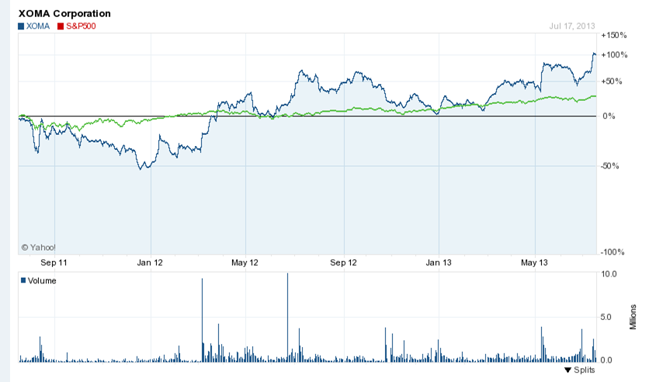
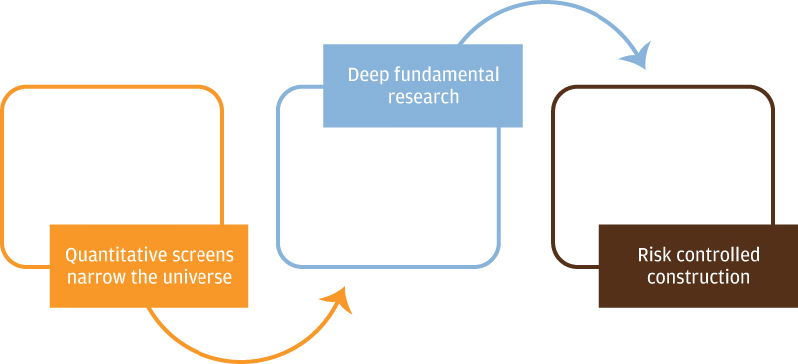
Manager-driven engine: Fundamental research, one stock at a time
Investment process
Searching for higher-than-average growth
The team narrows the investment universe utilizing proprietary quantitative screens, followed by deep fundamental research and strong emphasis on risk controls
XOMA Corporation
July 2011 – July 2013
The company above is shown for illustrative purposes only. Its inclusion in this presentation should not be interpreted as a recommendation to buy or sell.
Notes:
Staying with the healthcare theme, let’s look at a stock selection decision through the lens of our manager-driven engine for our Large Cap Growth strategy.
From a universe of 1000 stocks, the team wants to own 60-90 of the most attractive growth stocks. In this case, the management team is less concerned about the sector, and is focused solely on individual stocks. The team would be looking at growth stocks – companies that are growing faster than average. These tend to be found in new and more dynamic sectors of the economy, like telecommunications, health care, and biotechnology. Their prices also tend to be volatile, and they conserve capital to fuel future growth – so you won’t typically find dividend payments from these companies.
They will look for companies with higher price/earnings ratios than the market average. Here we show performance of a potential healthcare company called XOMA Corporation compared to the S&P 500 that might meet the team’s criteria.
The team is looking for potential for above-average, long-term price appreciation – which is typically assessed by fundamental research, such as meetings with management, competitors and suppliers. Specifically, they look for companies with potential to deliver significantly higher growth than market expectations over 3 to 5 years – those that have large defined markets, good price momentum and demonstrate potential to continue executing well.

Slide 13
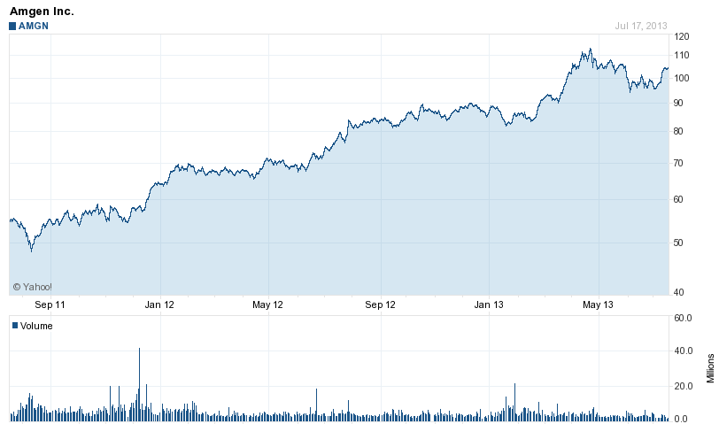
Behavioral investment engine: Capitalizing on persistent market inefficiencies driven by investor irrationality
Amgen Inc.
AMGN
July 2011 – July 2013
Bad news
earnings misses
B
SELL
Fundamental Value
Stock Price
BUY
A
Good news
earnings upgrades
<2 years
A
Investors under-react to good news about a company because they
are conservative
The stock price trends up (momentum) as investors slowly update their views.
Investors eventually bid the stock above fair value as they become over-confident in their own analysis. They extrapolate, assuming a good stock is representative of a good company.
High expectations are not met and this growth stock underperforms
Over-reaction to missed expectations can lead to a stock being excessively punished.
These value stocks subsequently outperform
B
A
The company above is shown for illustrative purposes only. Its inclusion in this presentation should not be interpreted as a recommendation to buy or sell.
Notes:
In another stock valuation approach, this example represents a growth strategy driven by our behavioral investment engine. The team starts with quantitative analysis that looks at both value and momentum factors. They’re looking to capitalize on market inefficiencies generated by irrational investor behavior.
On the left, the blue line is the fundamental value of a stock over the long term, while the grey line represents how stock prices move around that fair value. We want to buy Value stocks, benefit from rising prices (momentum) and sell once when they become over-value growth stocks. Investors typically under-react to good news about a stock because they are conservative when incorporating new information like earnings upgrades. This can lead to an upward trending stock price, or momentum, as investors slowly update their views.
Eventually this may lead investors to bid up a stock price beyond its fair value because they are over-confident in their own analysis and because they equate good stock performance with high future growth. Ultimately these expectations are not met and these glamour stocks underperform. Similarly, over-reaction to bad news can lead to a stock being punished excessively. Many of these value stocks subsequently perform well.
By combining sophisticated quantitative models with qualitative judgments they rank stocks according to certain desirable characteristics and single out companies with earnings momentum – that is, an increase in earnings per share from one reporting period to the next – earnings growth potential and price momentum. In this healthcare example, the team would want to buy Amgen when other investors have shunned the company and sell it when demand pushes the price up beyond rational expectations.

Slide 14
Valuing a stock: Key measures
Return on equity (ROE)
Earnings per share (EPS)
Price-earnings ratio (P/E ratio)
Price to cash flow
Dividend yield
FOR INSTITUTIONAL USE ONLY / NOT FOR PUBLIC DISTRIBUTION
Notes:
Most car buyers would probably have a list of four or five key factors that would influence their ultimate purchase decision – say, price, performance, fuel efficiency, safety, or resale value, for example.
Similarly, most stock selection methods – whether they’re quantitative or qualitative – would typically consider a variety of factors, such as return on equity, earnings per share, price-earnings ratio, price-to-cash-flow and dividend yield. Allow me to briefly review these:
Return on equity (ROE) is the price of a stock divided by the current year’s earnings per share. That’s an important metric because it has a direct impact on a company’s growth, profits, and dividends. It shows how successful the company is at managing its assets, operations, and capital. Stable or increasing ROEs are good indicators; falling ROEs are a red flag and probably should be avoided.
Earnings Per Share (EPS): Probably the most common measure – it takes into account the company’s net profits (after taxes and minus any dividends to preferred shareholders) divided by the number of outstanding common shares of stock. EPS is a common measure that makes it easier to compare one company to another, especially within the same sector.
Price-Earnings Ratio (P/E ratio) is another important metric that tells an analyst or an investor how the market values a stock. Generally, the lower the P/E ratio, the better the stock buy; the higher the P/E ratio, the more the market is willing to pay for each dollar of annual earnings. A high P/E ratio may be okay for some portfolios if other factors point to the potential for a company’s earnings to grow.
Price to cash flow: Increasingly more common, this variable may be more reliable because cash flows are more stable than earnings.
Dividend yield: Amount of the dividend a company pays (not all companies pay a dividend) expressed as a percentage of the stock’s price.
In the case of a quantitative model, these factors – along with several others – may be given a certain weighting; qualitative judgments also tend to rank these in terms of importance, as well.

Slide 15
Sources of company information
Company website
Form 10-k
Analyst reports
Subscription services (e.g., ValueLine, Morningstar)
Securities and Exchange Commission – online Edgar system
Business and financial journals
Conferences
FOR INSTITUTIONAL USE ONLY / NOT FOR PUBLIC DISTRIBUTION
Notes:
When researching stocks, a company’s annual report and financial statements are public documents, so the average investor has equal access to these materials.
But institutional investors enjoy a higher level of access to company management and sophisticated analytics that would be difficult, if not impossible, to replicate for the individual investor.
Analysts also attend industry-specific conferences and meetings, affording them access to far greater understanding of industry trends, competitive forces, technological advancements and legal or legislative obstacles and challenges that may impact an industry or a sector. For example, if you’re a healthcare analyst today, you’re probably looking at the sector with through the Obamacare lens and asking how different companies have and will respond to major changes in the future.

Slide 16
What to look for
From a company’s income statement:
Earnings growth
Earnings surprise
Stable or increasing margins
From a company’s balance sheet:
Debt
Cash (relative to annual sales)
Return on equity (higher is better)
Receivables and inventory (shouldn’t rise faster than sales)
From the cash flow statement:
Cash flow
From the management’s discussion and analysis:
What is the outlook for the future?
Are there any potential threats and uncertainties they expect to encounter?
FOR INSTITUTIONAL USE ONLY / NOT FOR PUBLIC DISTRIBUTION
Notes:
Career analysts are a lot like avid car collectors. They look under the hood of every company they track, searching for that single sparkplug that may hold the promise of a long-term payoff. And their research coverage on the companies continues indefinitely. A stock may not meet the manager’s criteria now, but it may at some point in the future. Analysts also pay special attention to stocks that are owned in a portfolio – or on a “watch list.”
In addition to the measures we’ve discussed – they read financial, trade and business journals, and carefully follow materials the company publishes – speeches, press releases, website announcements. An analyst wants to know everything that’s happening with a company he or she is covering – did the company launch a new product on time, did it deliver as promised, how are sales going. They also watch a company’s cash position very carefully.
When earnings reports are published – and the results differ from what analysts expect – positive or negative – it can cause a substantial movement in a stock’s price. Analysts carefully track these announcements and may recommend a buy, hold or sell decision based on an assessment of such announcements.

Slide 17
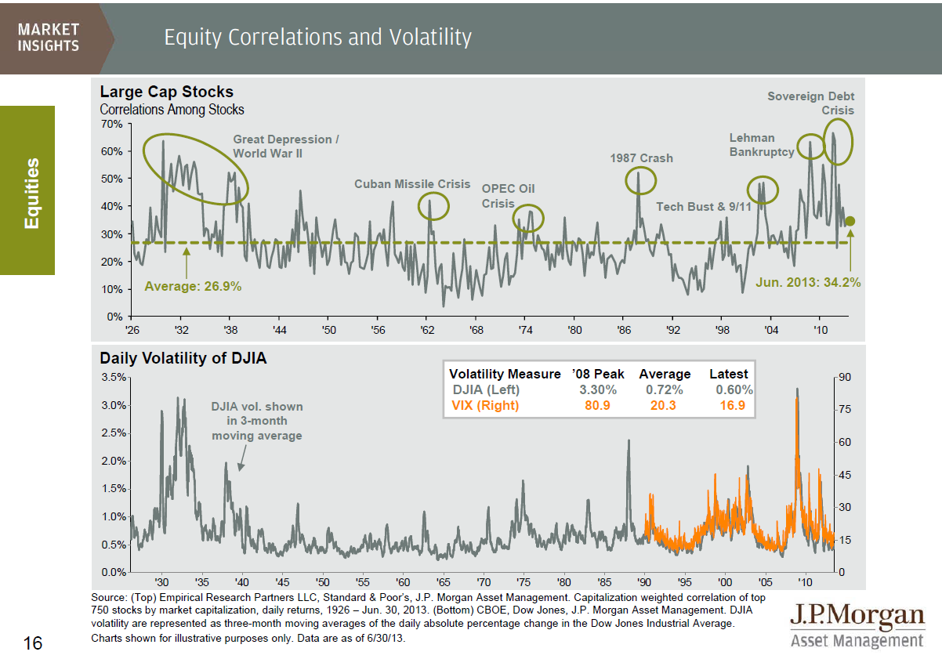
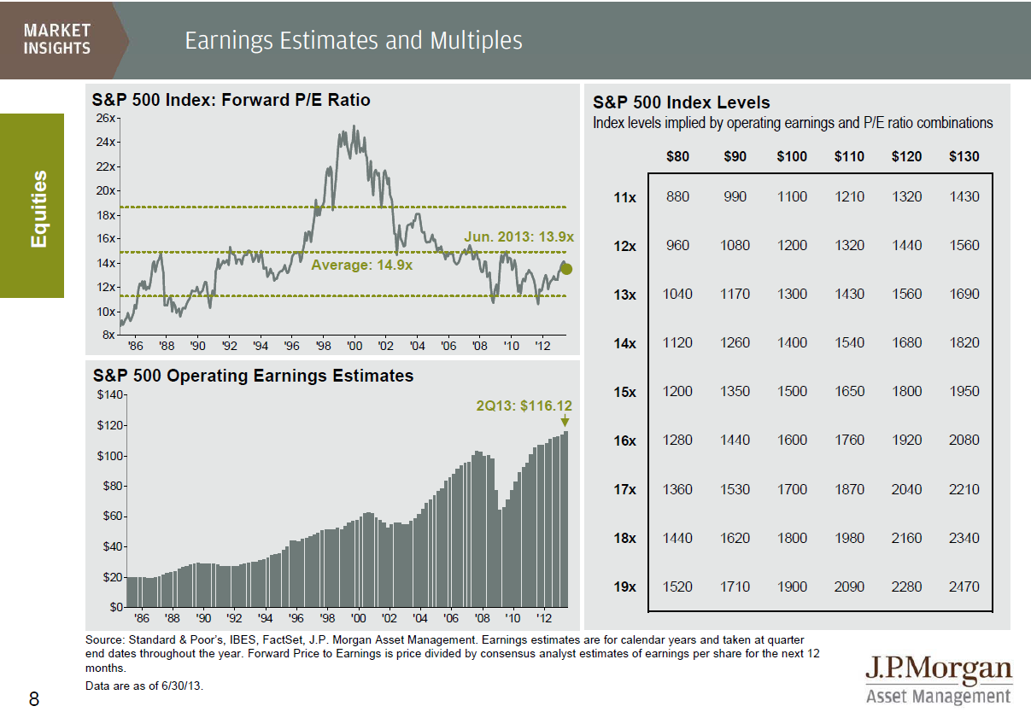
Back to fundamentals: A stock picker’s market
Source: Guide to the Markets, July 2013.
Notes:
As a way of concluding my presentation. I’d like to share a couple of slides from our Guide to the Markets that put today’s discussion in perspective with the current market climate.
At the height of the financial collapse fear led many investors to sell their stock holdings. They didn’t discriminate between companies that were run better than others, and consequently liquidated positions in quality stocks. That caused stock prices to deteriorate rapidly across the board. Our strategists note that, as the markets bottomed out and all stocks looked cheap, many got back into the market without regard for individual company fundamentals. The chart on the top of slide 16 illustrates the effect this behavior has had on the stock market by looking at the average correlation of large cap stock prices since 1926. Note how prices rise and fall sharply as investors bid prices up, then sell out of their equity positions. The chart on the bottom shows how volatile the stock market is during these periods.
Breaking down price into earnings and multiples can provide some context for what is reasonable to expect from equity markets going forward. The right side of slide 8 provides a simple matrix to estimate where the market is headed based on assumptions of earnings growth and multiples. If, for example, you assume 5% earnings growth over the next 24 months along with modest multiple expansion toward the mean, investors still stand to earn a reasonable price return in the future. Coupled with a consistent dividend yield of approximately 2% per year, the prospects for U.S. equity investors still look bright even though momentum is likely to slow.
Our strategists believe that we are entering a stock picker’s market, in which the quality of research may matter more than ever. They advise investors to consider hiring experienced managers that employ a disciplined stock selection process based on quality research, as historically, this approach tends to be the best way of exploiting market inefficiencies.

Slide 18
Summary
Research matters
When evaluating a company for investment, a stock’s price may not be its true value
In a global universe of 50,000+ stocks, analysts narrow their search
Analysts and portfolio managers employ various methods, strategies and models to select stocks
Important equity valuation measures:
Return on equity (ROE)
Earnings per share (EPS)
Price-earnings ratio (P/E ratio)
Price to cash flow
Dividend yield
Notes:
To summarize our discussion today, when evaluating investment ideas, research really matters because a stock’s price, alone, may not be its true value.
With more than 50,000 stocks worldwide, analysts and portfolio managers often start by narrowing their search by factors such as geography, market capitalization and/or industry sector.
We also learned today that there is no single way to evaluate and choose stocks – rather, there are hundreds of methods. Most organizations use a combination of qualitative and quantitative techniques and models in the stock selection process.
Some of the most important variables investors assess when evaluating a stock are return on equity; earnings per share; price-earnings ratio; price to cash flow and dividend yield.
Additionally, analysts read financial, trade and business journals, and carefully follow company speeches, press releases and website announcements. Analysts want to know everything that’s happening with a company he or she is covering – did the company launch a new product on time, did it deliver as promised, how are sales going. They also watch a company’s cash position very carefully.

Slide 19
Thank you
Notes:
Thank you for your time today and the opportunity to share our views on valuing equities – and how portfolio managers evaluate and choose stocks. We look forward to bringing you more insights from our Investment Academy series.
It’s a vast, global marketplace that’s constantly changing and an exciting time to be an investor.

Slide 20
Disclosure
The above commentary is intended solely to report on various investment views held by J.P. Morgan Asset Management. Opinions and estimates offered constitute our judgment and are subject to change without notice, as are statements of financial market trends, which are based on current market conditions. We believe the information provided here is reliable, but do not warrant its accuracy or completeness. This material is not intended as an offer or solicitation for the purchase or sale of any financial instrument. The views and strategies described may not be suitable for all investors. This material has been prepared for informational purposes only and is not intended to provide, and should not be relied on for, accounting, legal or tax advice. References to future returns are not promises or even estimates of actual returns a client portfolio may achieve. Any forecasts contained herein are for illustrative purposes only and are not to be relied upon as advice or interpreted as a recommendation.
J.P. Morgan Asset Management is the marketing name for the asset management businesses of JPMorgan Chase & Co. Those businesses include, but are not limited to, J.P. Morgan Investment Management Inc., Security Capital Research & Management Incorporated and J.P. Morgan Alternative Asset Management, Inc.
© J.P. Morgan Chase & Co., July 2013
FOR INSTITUTIONAL USE ONLY / NOT FOR PUBLIC DISTRIBUTION

Slide 21
声明：
所有的版权属于原有公司，文件均来自公开渠道
此文件仅供学习使用，任何人不得进行以此为商业目的的行为
如有疑问，请立即删除
学习世界五百强和咨询公司PPT课程请访问如下网站搜索：“司马懿”
百度传课：司马懿PPT学校
https://www.chuanke.com
网易学堂：司马懿PPT学校
https://study.163.com
知乎： 司马懿PPT学校
https://www.zhiu.com

